Slide 1

Electrical Vehicle Analysis
By Yaw Nimo-Agyare, Trevor Hitchcock, Sahil Ghelani

Slide 2
Table of Contents
Questions asked about the dataset
Process of cleaning the Dataset
Analysis
Dashboard
Questions

Slide 3
Questions asked about the dataset
1. Which Electric Vehicle manufacturers sells the most in Washington?
2. ⁠Which City has the most electric vehicles?
3. ⁠What percentage of electric vehicles are hybrid or fully electric. Which is more prevalent?
4. ⁠Which models offer the longest and shortest electric range?
5. What’s the correlation between vehicle range and the year?

Slide 4
Cleaning Data
To clean the data we removed duplicate entries
Changed missing entries to zero
Standardized data format (text columns, numeric columns), validated geographic data by ensuring city, state, and postal code align with real-world data.

Slide 5
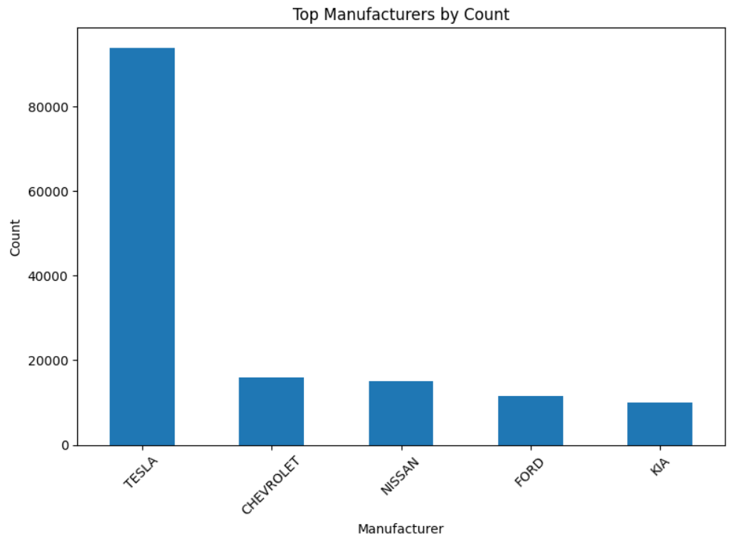
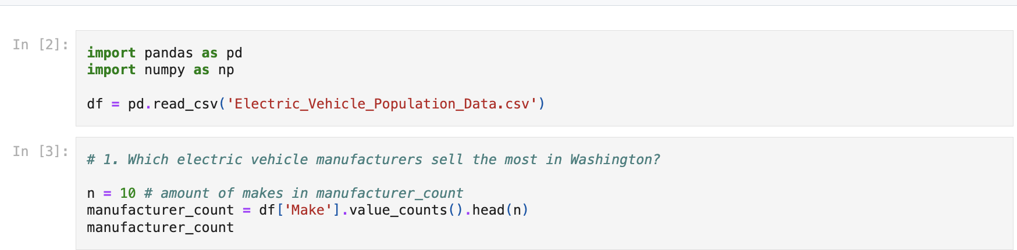
1.Which Electric Vehicle Sells the most in Washington?

Slide 6
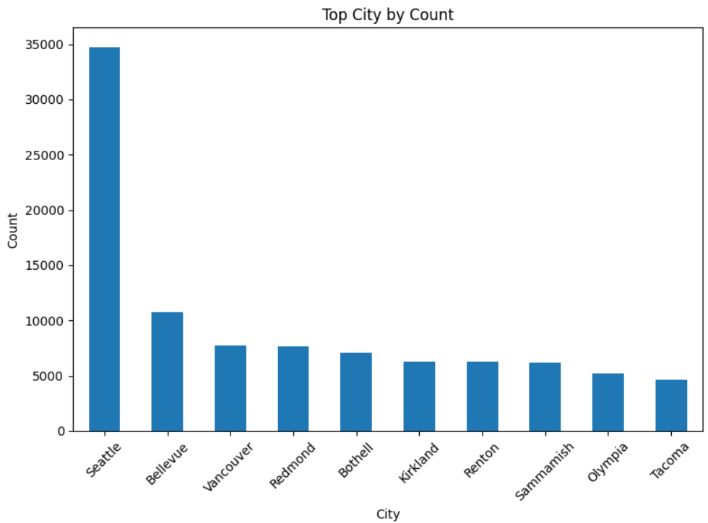
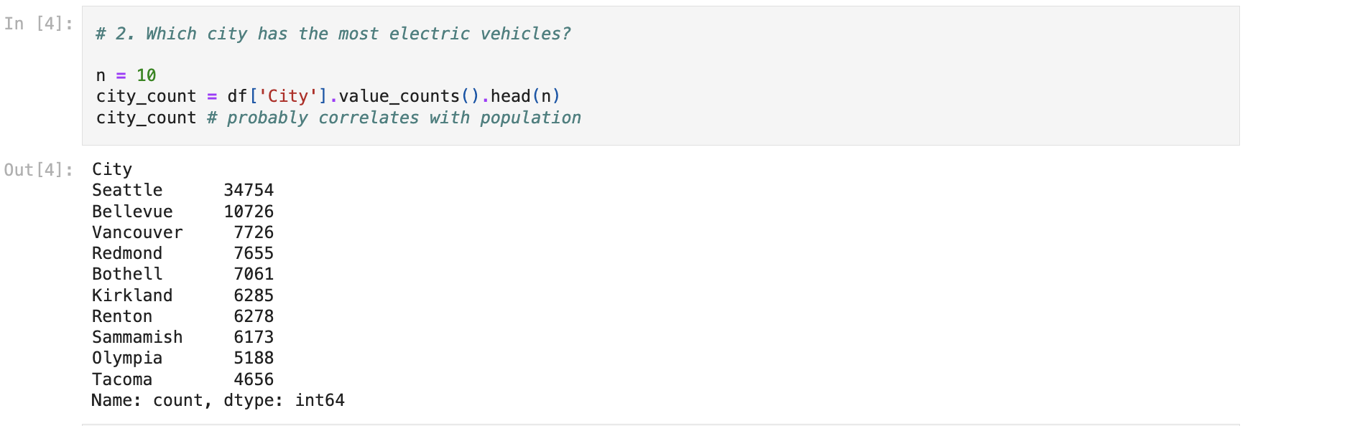
2. Which City has the most electrical vehicles

Slide 7
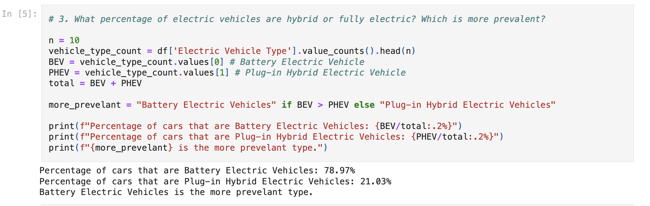
3. What percentage of Electric Vehicles are hybrid or fully electric. Which is more prevalent?

Slide 8
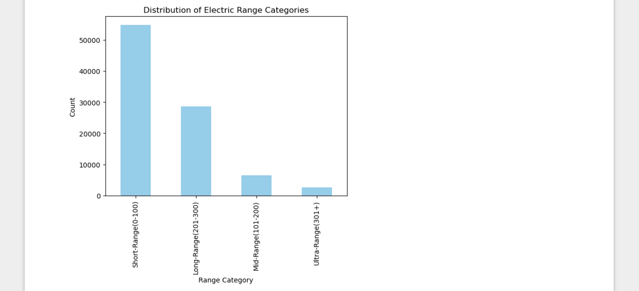
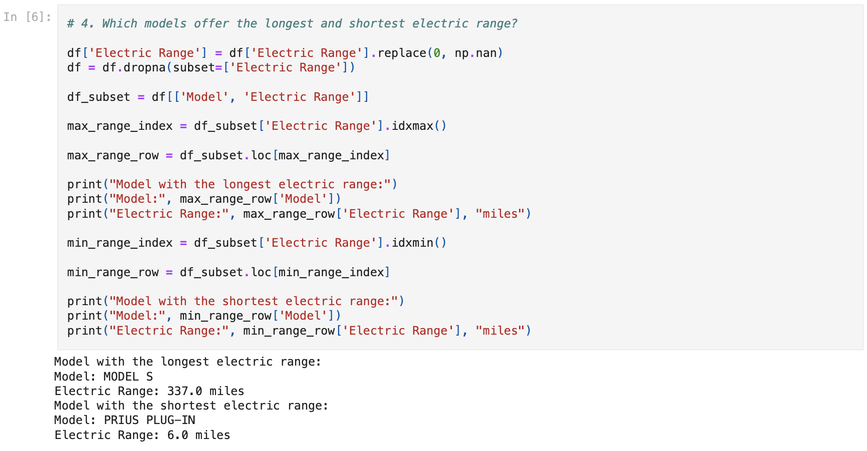
4. Which models offer the longest and shortest electric range?

Slide 9
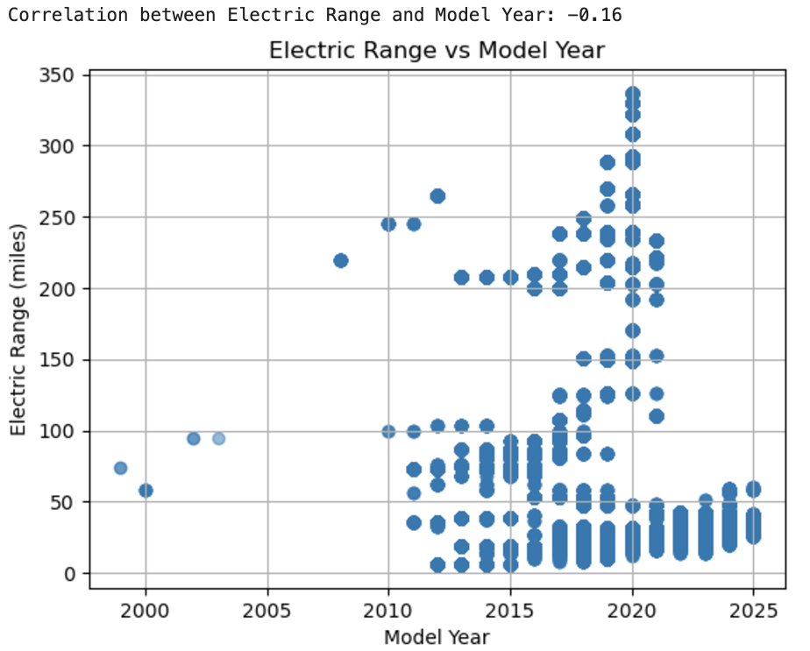
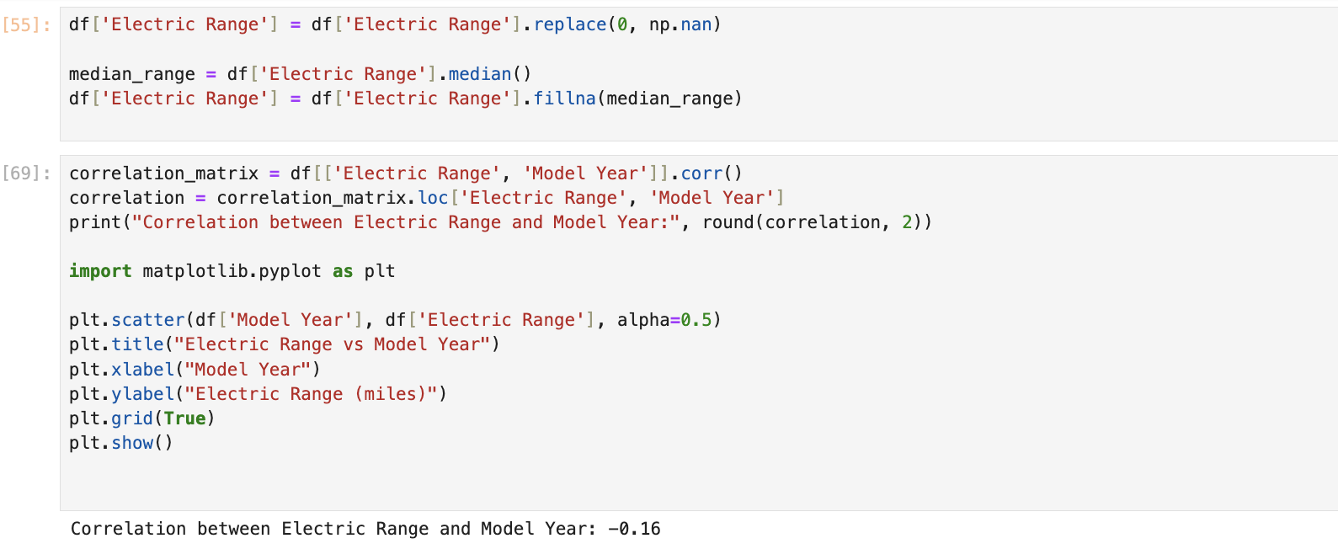
5. What’s the correlation between vehicle range and the year?
Ultra-range vehicles are less common due to their cost of production and underdeveloped technology.
Positive: Manufactures could see this as an opportunity to develop ultra-range vehicles depending on the demand.

Slide 10
Dashboard

Slide 11

Thank you for Listening. Any Questions?

